Slide 1



[ TARGET STATUS: SYS_CRITICAL_REPORT ] GRID RISK THREAT RADAR
R187B
Annual Economic Impact Broad macro-economic downtime and grid disruption losses
SECURING OUR CRITICAL LIFELINES
South Africa's core infrastructure is systematically degraded by industrial-scale syndicates. Cable theft, grid sabotage, and base station looting cost billions and paralyze vital public utilities.
R7.0B
Direct SOE Losses Physical asset replacement and infrastructure damage costs

Slide 2

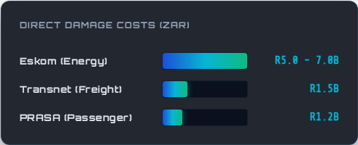
[ SYSTEM DIAGNOSTICS: COST_METRICS ] DAMAGE LOSS REPAIR INDEX
DIRECT YEARLY DAMAGE METRICS
Eskom Grid Sabotage: High-risk substation looting, transformer oil draining, and steel structural lattice pylon damage.
Transnet Logistics Theft: Copper overhead traction cables systematically stripped across vital freight lanes.
PRASA Rail Decay: Mass targeting of station sub-assemblies and copper wiring halting public rail routes.

Slide 3



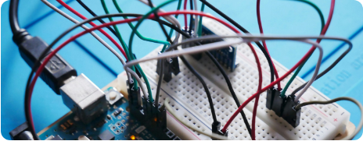

[ SPECIFICATION DETECT: HARDWARE_EDGE ] IOT PROTECTIVE RADIAN
ARDUINO EDGE HARDENING
Rugged Sensor Node Deployment
SentinelAI builds hardened IoT field modules using real-time edge micro-controllers to process spatial alerts and isolate structural tampering on impact.
Multi-Sensor Fusion Arrays: Accelerometer, vibration, and thermal layers analyze threats natively on the asset.
Grid-Independent Backhaul: Battery arrays combined with encrypted LoRaWAN meshes resist power outages.

Slide 4





[ SYSTEM ARCHITECTURE: SIGNAL_ROUTE ] INCIDENT INGESTION FLOW
THE SECURE DATA FLOW MATRIX
1. Edge Intercept
2. Encrypted Packet
3. AI Prediction
4. Incident Dispatch
Arduino nodes process vibration frequency shifts and tilt variables on-site, filtering false ambient reports.
Secured LoRaWAN structures route high-priority coordinate payload through local wireless grid controllers.
Our secure central cloud database maps alerts against target trends to flag localized systemic sabotage.
Direct spatial alerts and secure geographic coordinates route immediately to tactical infrastructure guards.

Slide 5




[ SYSTEM SPEC: SOFTWARE_HARDWARE_INTEGRATION ] SENTINEL_AI_STACK_VERSION_2.5
TECHNOLOGY INTEGRATION STACK
IOT HARDWARE NODES
SECURE BACKEND
Low-power, solid-state modular edge systems built for long-term field durability in harsh South African environments.
Enterprise-scale API endpoints designed for rapid sub-second payload parsing, secure hashing, and real-time alerts processing.
OPERATIONAL FRONTEND
AI PREDICTIVE CORE
High-contrast, low-latency administrative interface highlighting current target threat indicators and node health metrics.
Machine Learning engine modeling structural attack patterns and localized risk probabilities to dynamically dispatch guards.

Slide 6



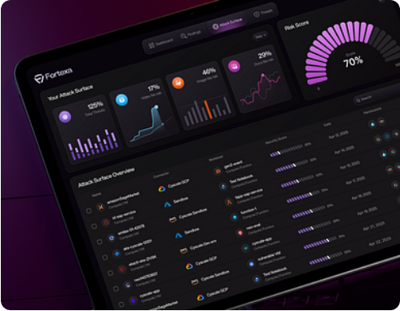
[ DISPLAY CONSOLE: CENTRAL_OPERATIONS ] MUNICIPAL THREAT INTERFACE
OPERATIONAL COMMAND CONSOLE
Target Map & Operator Hub
Designed specifically for municipal security desks and critical national asset monitoring units. High-level dashboard displays visual threat vectors instantly.
Real-Time Threat Mapping: Displays flashing regional coordinate alerts on precise satellite telemetry layers.
Active Alarm Matrix: Dynamic escalation queue classifying events from ambient vibration up to absolute hardware damage.

Slide 7







[ SYSTEM EVALUATION: DEPLOYMENT_METRICS ] DEFENSE EFFECTIVENESS INDEX
DEFENSIVE OPERATIONAL OUTCOMES
-92%
<3m
10x
VANDALISM REDUCTION
DISPATCH ACCELERATION
TAXPAYER ROI YIELD
Deployments show near-total drops in structural copper wire stripping and regional utility box intrusions.
Encrypted telemetry signals directly alert patrol vehicle terminals, bypassing communication bottlenecks.
Automated mitigation prevents expensive hardware replacement cycles and prolonged load restoration outages.

Slide 8

[ PARTNER GATEWAY: INITIATION ] NATIONAL SECURITIES INTEGRATION
Securing South Africa's Digital Infrastructure
SentinelAI represents a fundamental leap in municipal utility protection. Our immediate vision is to integrate physical IoT edge node shields across national smart grids, railway structures, and water delivery matrices to safeguard the state's most critical assets.
admin@sentinelai.gov.za
|
www.sentinelai.gov.za

Slide 9





[ SYSTEM BIBLIOGRAPHY: IMAGERY_REGISTRY ] VERIFIED IMAGERY REGISTER
SYSTEM IMAGE REGISTRIES
http://googleusercontent.com/image_collection/image_retrieval/6172972075828967462_0
Module 1: Arduino IoT Edge Module Board
https://waterfall-security.com/wp-content/uploads/2025/06/How-industrial-cyber-security-works-in-2025-1.png
Module 2: OT Industrial Threat Diagnostic Monitor Dashboard
http://googleusercontent.com/image_collection/image_retrieval/91162182616022394_0
Module 3: Gov & Municipal Command Console UI

Slide 10




IMAGE SOURCES
https://images.unsplash.com/photo-1631378297854-185cff6b0986?fm=jpg&q=60&w=3000&ixlib=rb-4.1.0&ixid=M3wxMjA3fDB8MHxzZWFyY2h8OHx8bWljcm9jb250cm9sbGVyfGVufDB8fDB8fHww
Source: unsplash.com
https://cdn.dribbble.com/userupload/43439112/file/original-9b2d76da668971a2fa5a1914729b4671.png?resize=400x0
Source: dribbble.com

